Slide 1
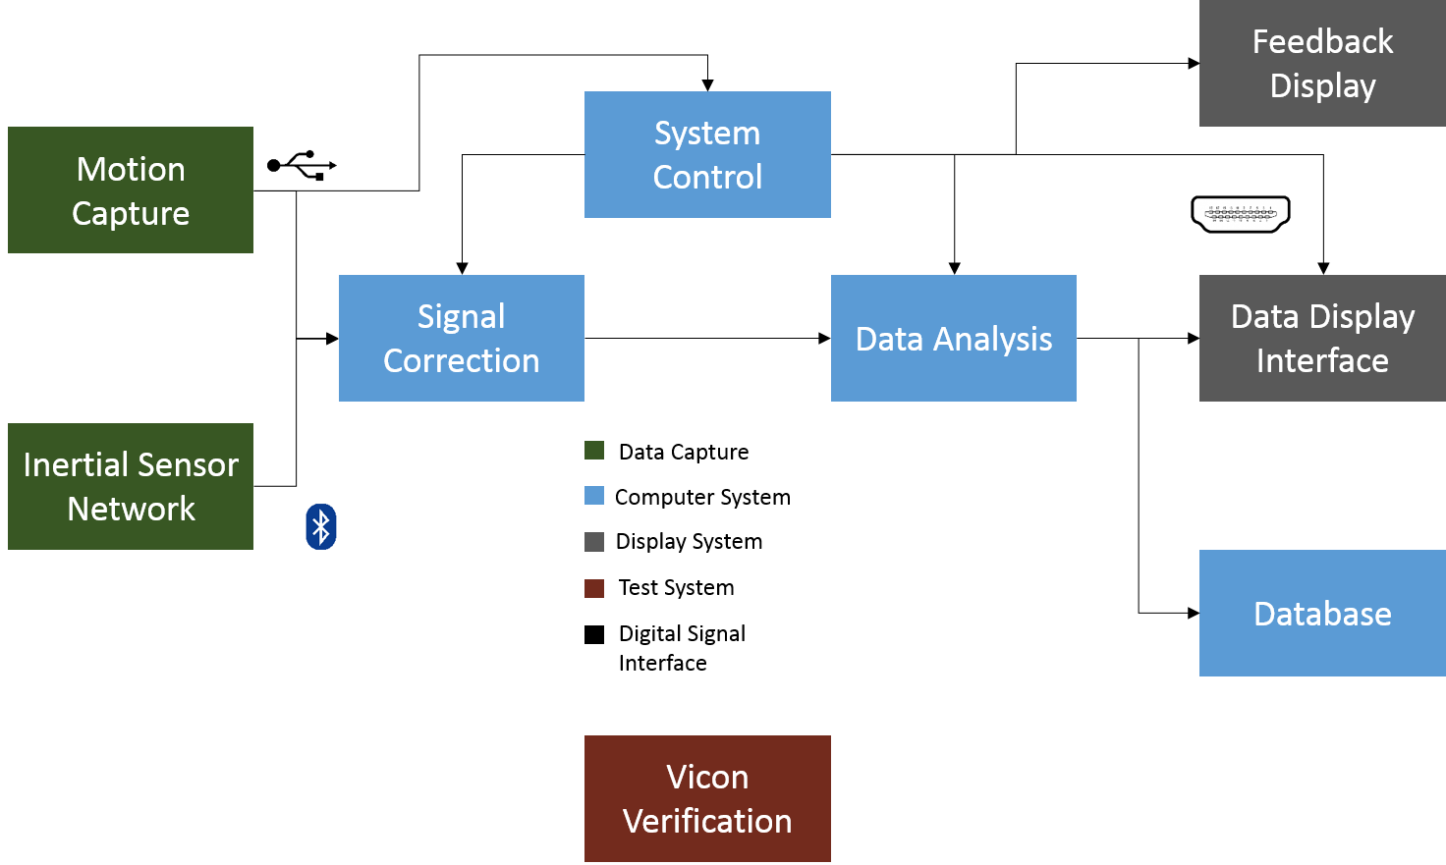
Block Diagram

Slide 2
Benjamin Johnston
Sensor Characterization
Drift
Offset
Synchronize
Vicon
Subject matter expert
Sensor accuracy

Slide 3
Benny Chan
Kinect Characterization
Accuracy w/ Vicon comparison
Integrating sensors and synchronization
Gesture Control
Goes into feedback
Vicon
Subject matter expert
Framing Kinect and Vicon to same origin

Slide 4
Kevin Burns
Signal Correction Programming
C# programming of MATLAB
Drift correction
Synchronization
Filtering
Visualization
System Control
Error handling
System instructions

Slide 5
Alex Dubois
Database
Create database structure
Database interface from system
Data Analysis
C# programming
Position, Velocity, Acceleration, Jerk calculations
LBD Quantification
GUI
C# development of user interface
Data and error displays to technician

